Slide 1
VDR structure and Functioning

Slide 2
VDR structure and Functioning
WSIMOD setup
API development
WSIMOD use
WSIMOD + API
final WSIMOD
MODELLING
spatial
domain
VDR
workflows
VDR
prototype
VDR
testing
VDR use
DIGITAL
final VDR
problem
formulation
CLD development
SYSTEMS
THINKING
CLD + VDR
final
CLD
ENGAGEMENT
scoping
workshops
VDR workshops
CLD workshops
VDR feedback
VDR use
SHOWCASE
API = Application Programming Interface
CLD = cause and loop diagram
VENTURA framework for water neutral planning

Slide 3
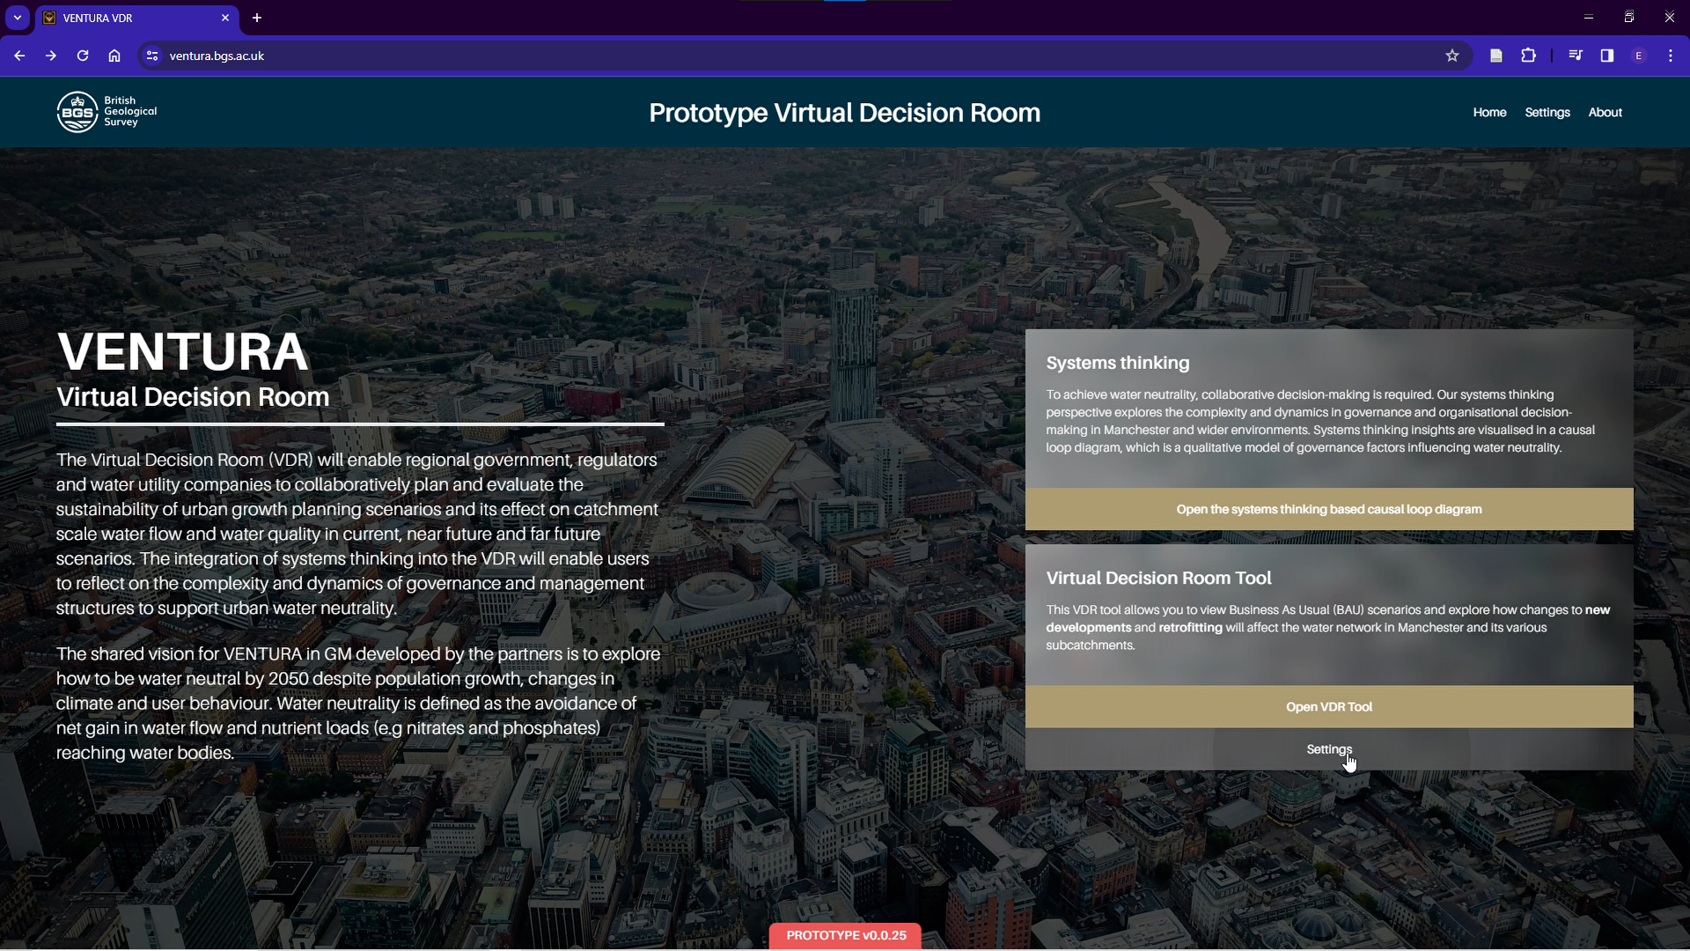
VDR structure and Functioning
Welcome screen

Slide 4
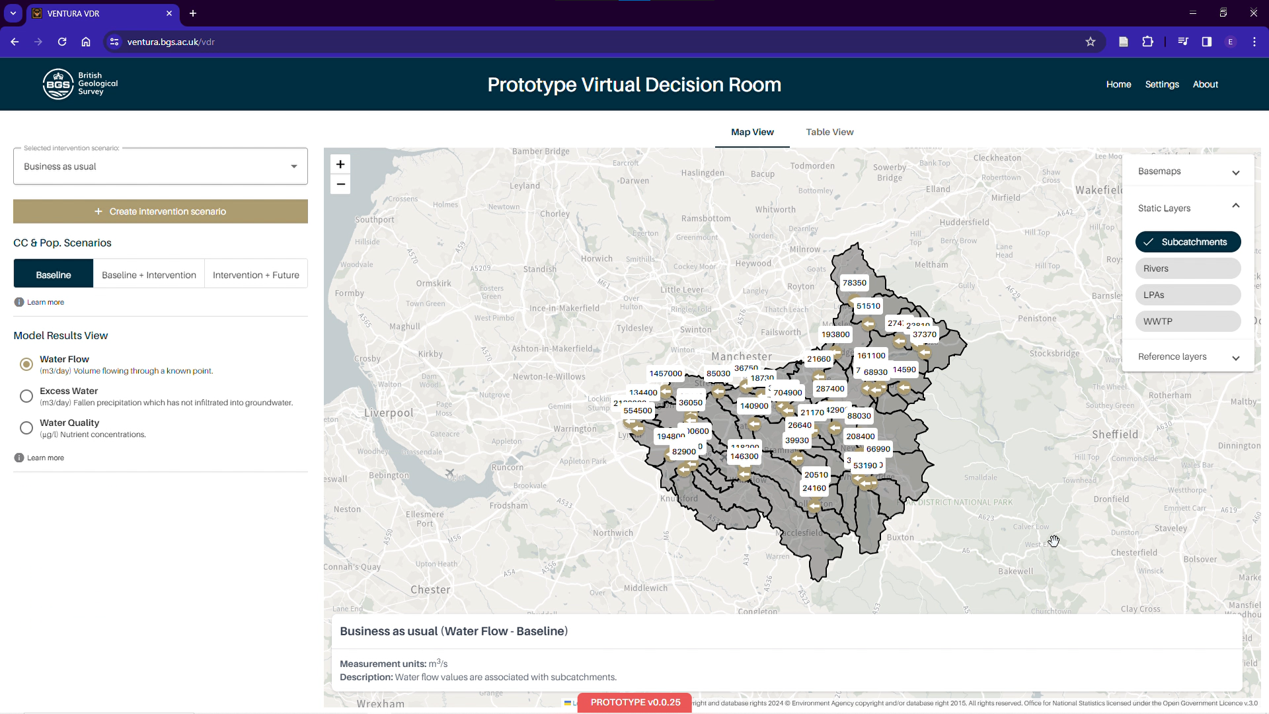
VDR structure and Functioning
Central map
Background information layers
scenario explorer (empty at first use)
Introduction and exploration screen

Slide 5
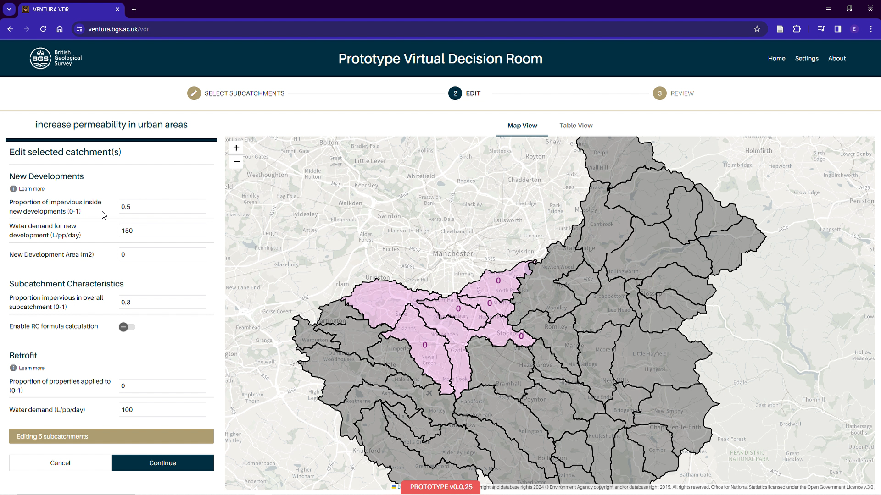
VDR structure and Functioning
Sub catchment characteristics
Manual sub-catchment selection
Move to calculation
Scenario definition and use

Slide 6
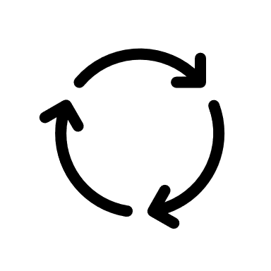
VDR structure and Functioning
VDR calculation
WSIMOD evaluation in the background

Slide 7
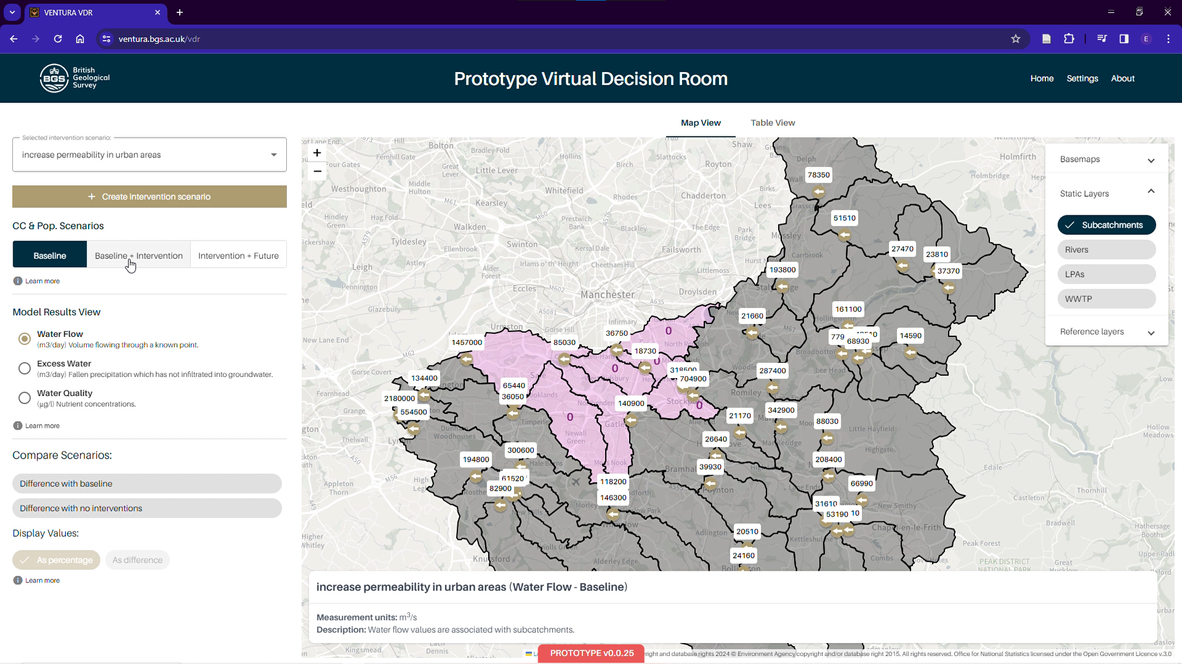
VDR structure and Functioning
Outcomes are shown at the “gates” of these catchments
Results explorer by water flow, excess or quality
Allows comparative analysis
Results explorer

Slide 8
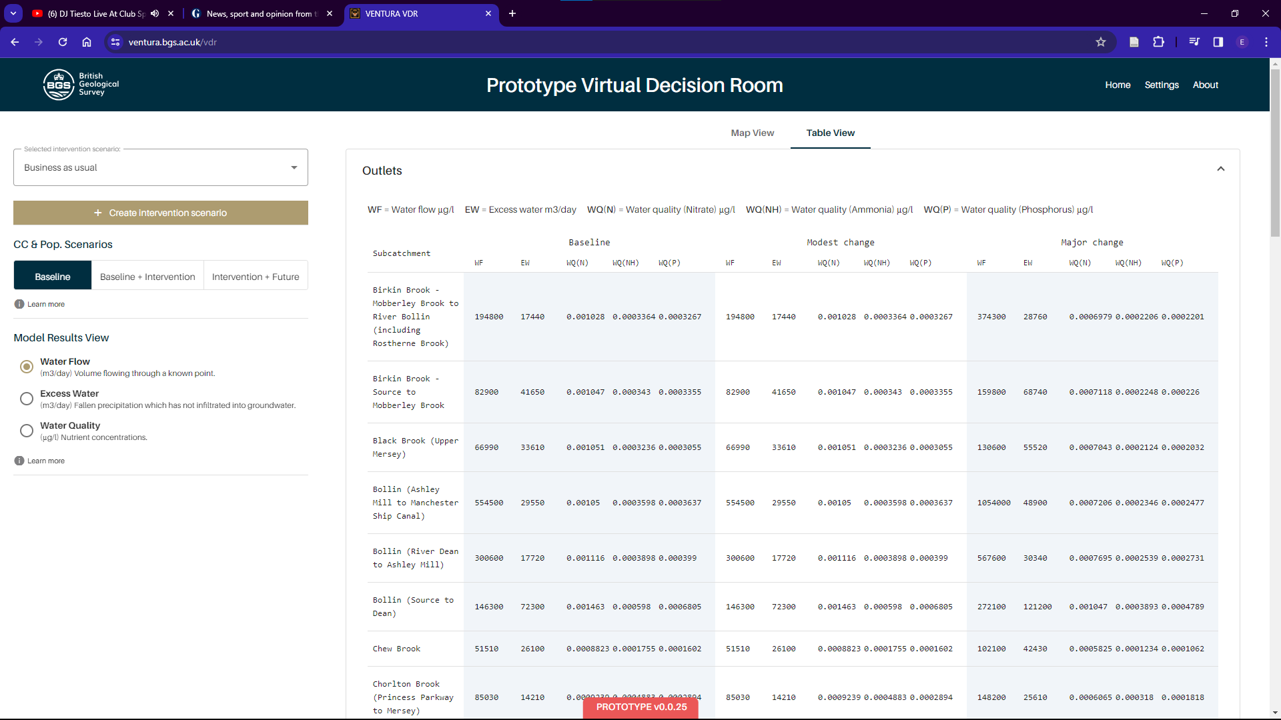
VDR structure and Functioning
Results explorer (table)

Slide 9
Data familiarisation

Slide 10
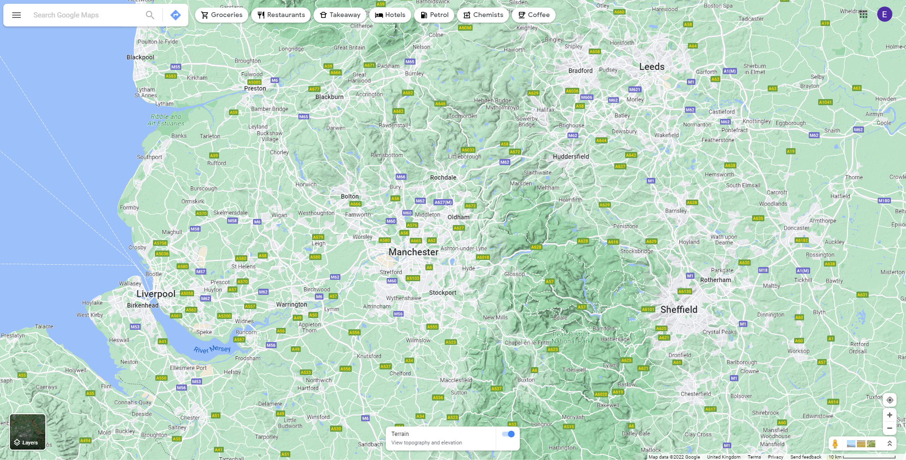
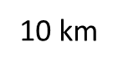
Data familiarisation
Manchester context

Slide 11


















Data familiarisation
Upper Mersey catchment
Other catchments
Manchester context

Slide 12
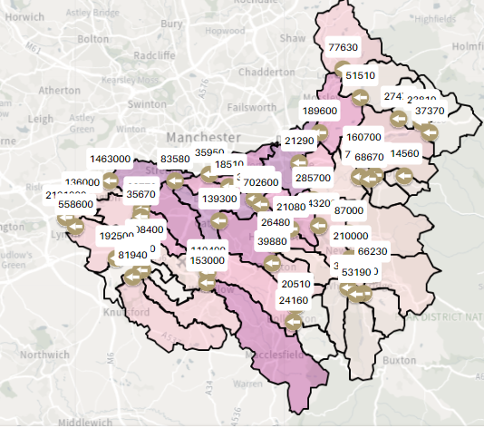
Data familiarisation
BASELINE DATA
total population of 1,058,917 people
Typically consume 143l/p/d
Av. Demand 143,000m3/d
RIVER FLOWS
2,180,000m3/day flow at the outlet
2,180,000m3/day
Baseline data - flows

Slide 13
Data familiarisation
REDUCED HOUSEHOLD DEMAND:
Bring all demand to the minimum (50l/p/d)
Final flow is 2,088,000m3/day (roughly 92,000m3/d, which is 90l/p/d for 1Mp)
2,080,000m3/day
Sanity check - flows

Slide 14
Data familiarisation
ALL CATCHMENTS IMPERVIOUS:
If we turn all catchments impervious (99% imp) the max flow in the outlet goes to 3,500,000m3/day
ALL CATCHMENTS PERVIOUS:
If we turn all catchments totally natural (1% imp), it comes down to 2,027,000m3/d
3,500,000m3/day
2,027,000m3/day
Extreme tests - flows

Slide 15
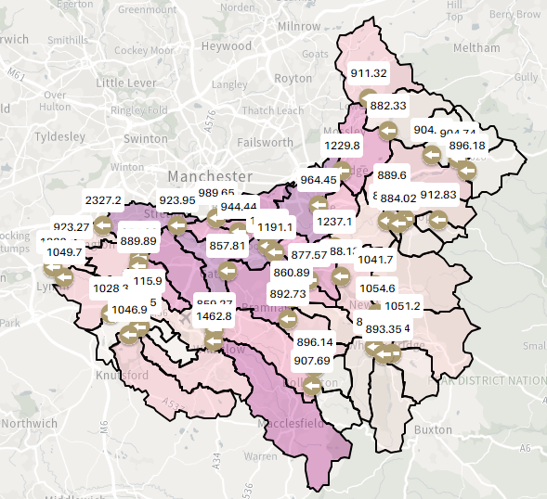
Data familiarisation
BASELINE POLLUTANTS IN OUTLET (143l/p/d)
1823 ppm Nitrogen
771 ppm Phosphorous
395 ppm Ammonia
1823 ppm Nitrogen
771 ppm Phosphorous
395 ppm Ammonia
Baseline data - Pollutants

Slide 16
Data familiarisation
POLLUTANTS FOR DEMAND REDUCTION (50l/p/d)
1,171 ppm Nitrogen
367 ppm Phosphorous
267 ppm Ammonia
1,171 ppm Nitrogen
367 ppm Phosphorous
267 ppm Ammonia
Extreme tests - pollutants

Slide 17
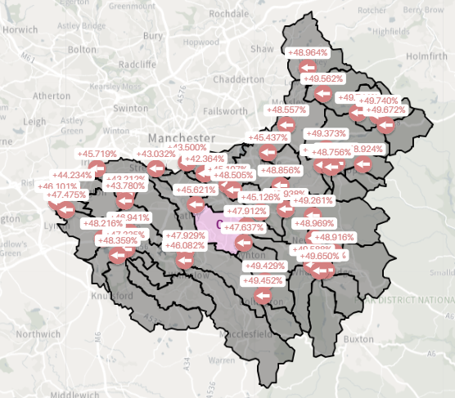
Data familiarisation
FUTURE TRENDS SCENARIO
Pop increase=30%
Rainfall increase=50%
+46% flows
-46% [N]
-45% [P]
-43% [Amm]
+46% flows
-46% [N]
-45% [P]
-43% [Amm]
Future scenario test

Slide 18
VDR live test

